Slide 1

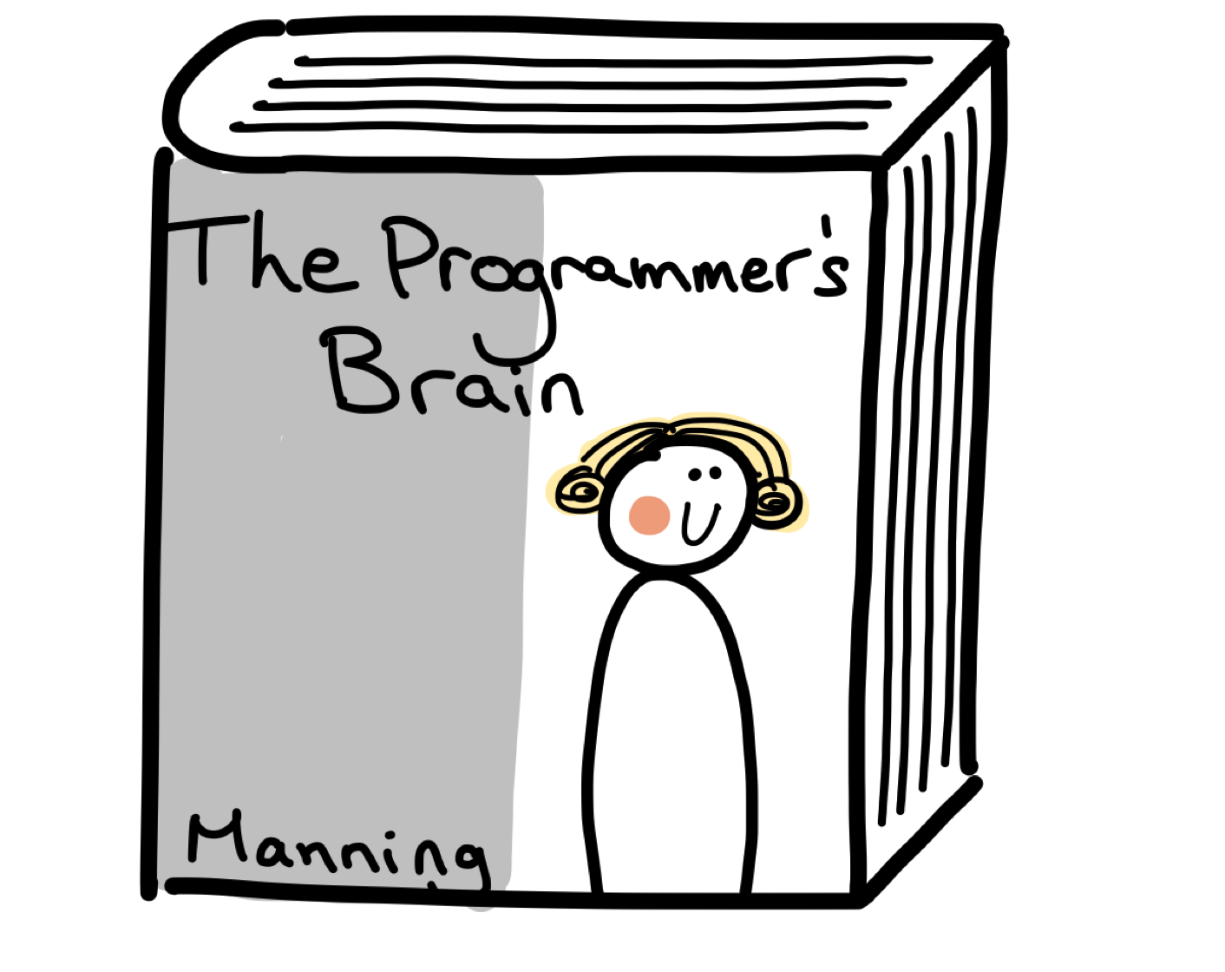
Developer Psychology

Slide 2

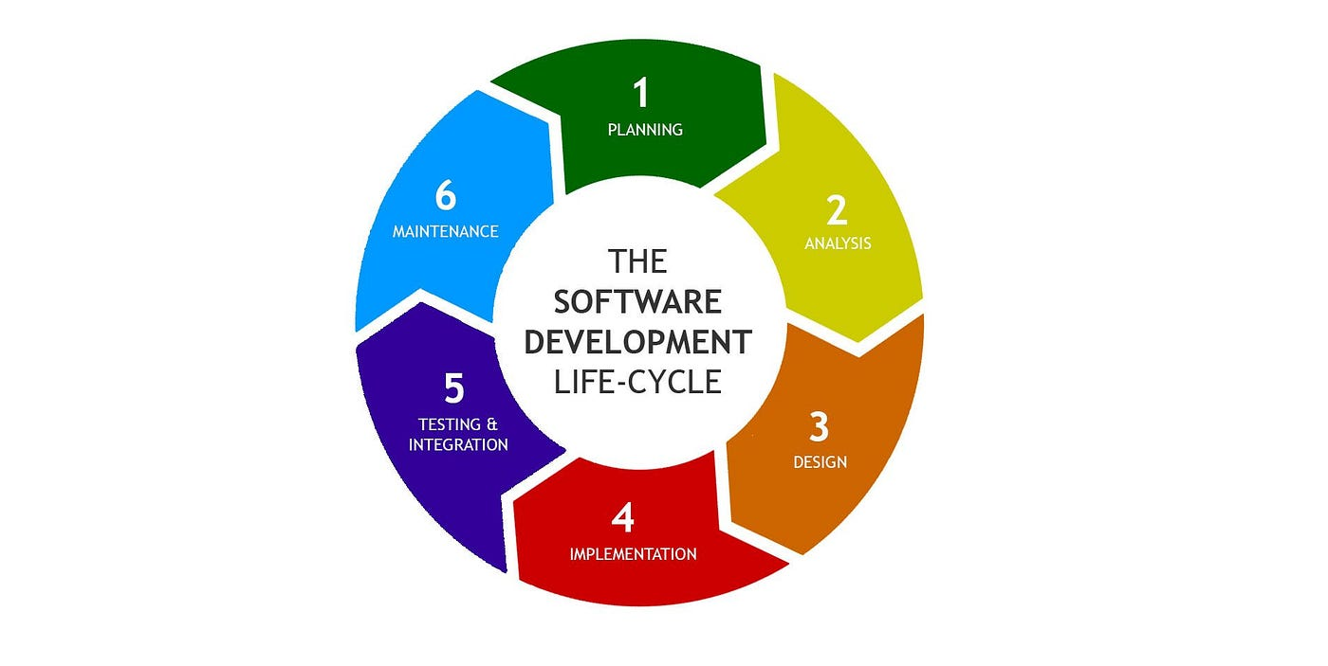
Who should you hire to develop software?
Anyone who does their job well!
Diversity is Inclusion
Notes:
Devs are easily annoyed but rarely frustrated
Some devs are detail-oriented; others are big-picture

Slide 3

NO!!
Notes:
But maybe your pet cat can walk on your keyboard if you’re a Perl developer

Slide 4

Every piece of the puzzle has different squiggles
Architect – Big Picture
Staff Engineer – Details
Data Engineer – Gardener with a cookbook
Data Scientist – Executive chef allergic to dirt
SDET – Lazy
Manual Tester – Obsessive
Notes:
Match the psychology to the role
That’s not an excuse for siloing or refusing to adapt – the best architects code; the best staff engineers articulate the big picture impact.
Data Engineers accomplish clear tasks with messy data; Data Scientists complete unclear objectives with cleaned data
At MO Reliability Test Automation Architect Peter Foldhazi later told me he was “very lazy”

Slide 5

Manual Testers
Excuse me, Womanual Testers
OCD Hall Monitor Valedictorian Self-Hating Perfectionist
They take pride in the strangest things
Notes:
They tend to obsess on things that matter to them, like cleanliness or their career
With some technical knowledge they might be good pen testers

Slide 6

Tier 3 Support
Polite
Easily addicted to video games
Notes:
Grinding with less creativity than an SDET

Slide 7

Autism
Sensory Overload
Think in pictures
Special Interest
Notes:
Falsy positive – directed to technology because of stereotypes

Slide 8

People who are harder to get along with …
Borderline personality disorder
Alcoholics
Notes:
BPD feels neurotic about connections so they relentlessly test them. They may make good chaos engineers or red team hackers
Don’t let your baby cry it out!
Alcoholics might be good UAT since they are closer in mental state to the average user

Slide 9
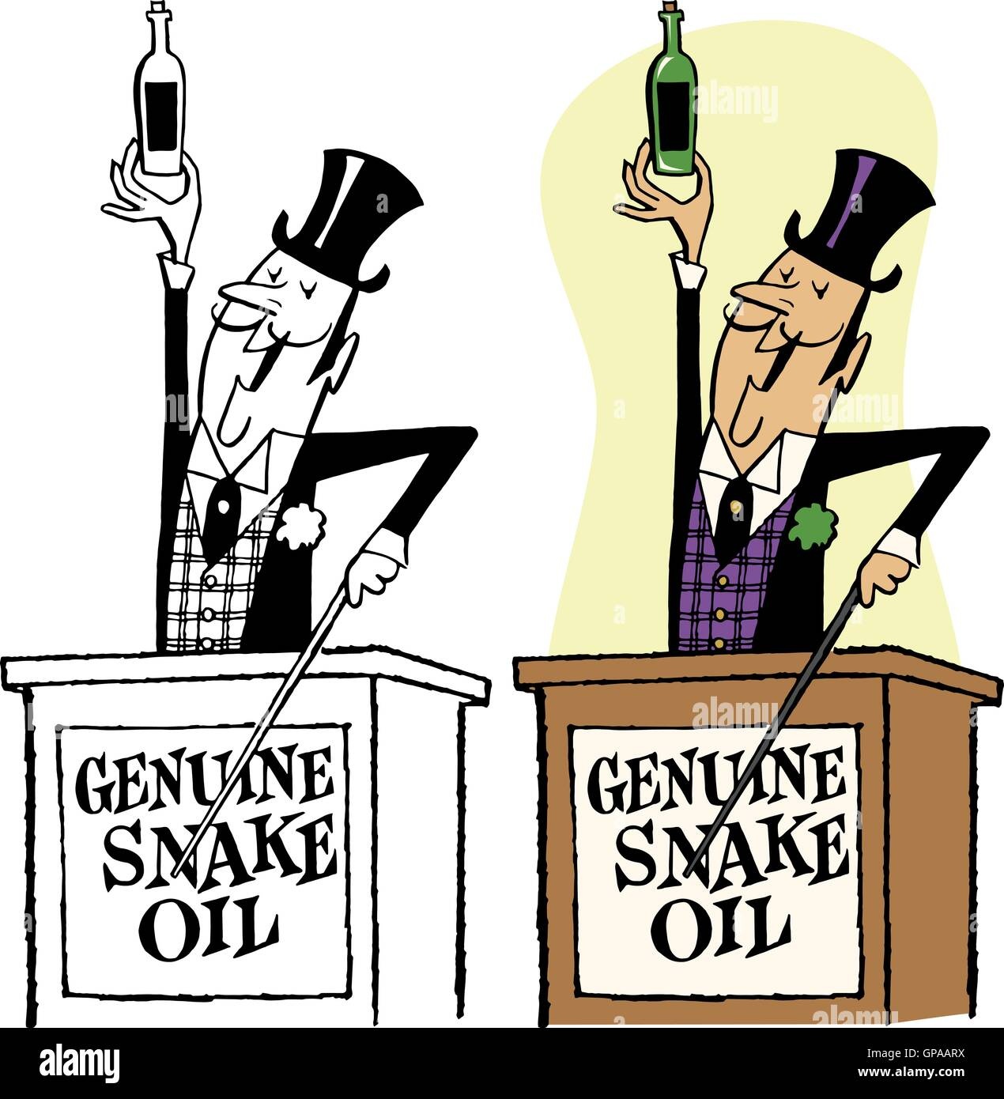
Falsy Positives
Charlatan
Trivial pursuer
LeetCode Monkey
Anti-social savant
Notes:
Good at thinking in code and explaining it – LeetCode
Commits to projects and fluent in production – Portfolio
Trained – work history
Portfolio, but does it look machine generated?
Minimum IQ - brain teasers
Take home – but paid
LeetCode – but can they understand production systems?

Slide 10

Neurology aside …
EE/Math/TPM
Math/Chemistry/Music
Actuarial Science/Risk
UI/UX/Tier 3 Technical Support
Get a hobby!
Notes:
The brain is plastic, it’s not just how you’re naturally wired but also what wiring you’ve cultivated for yourself
Software development is downstream of Math, Electrical Engineering, and Technical Product Management
Math, Chemistry, and Music require symbolic manipulation and/or asynchrony
Actuaries may be better at estimating risk/reward for greenfield or refactorizations or A/B tests
UI/UX and Tier 3 splunk monkeys have a better understanding of the client experience

